Slide 1
Week 1 - Getting Situated in R and tidyverse
Emorie D Beck

Slide 2
Course Goals & Learning Outcomes
Understand the cognitive and psychological underpinnings of perceiving data visualization.
Identify good data visualizations and describe what makes them good.
Produce data visualizations according to types of questions, data, and more, with a particular emphasis on building a toolbox that you can carry into your own research.

Slide 3
Course Expectations
~50% of the course will be in R
You will get the most from this course if you:
have your own data you can apply course content to
know how to clean clean, transform, and manage that data
today’s workshop is a good litmus test for this

Slide 4
Course Materials
All materials (required and optional) are free and online
Wickham & Grolemond: R for Data Science https://r4ds.had.co.nz
Wickham: Advanced R http://adv-r.had.co.nz
Wilke: Fundamentals of Data Visualization https://clauswilke.com/dataviz/
Healy: Data Visualization: A Practical Introduction https://socviz.co
Data Camp: All paid content unlocked

Slide 5
Assignments
Assignment Weights | Percent
Class Participation | 20%
Response Papers + Visualizations | 20%
Final Project Proposal | 10%
Class Presentation | 20%
Final Project | 30%
Total | 100%

Slide 6
Assignments
Class Participation
There are lots of ways to participate, both in and outside class meetings
Classes will be technologically hybrid
The goal of this is for accessibility and to create recordings
If you need to miss 2 classes (i.e. 20% of total class time), maybe consider taking the course in a different year
If you must miss class, please let me know ahead of time if possible

Slide 7
Assignments
Response Papers / Visualizations
The main homework in the course is your weekly visualization assignment
The goal is to demonstrate how the principles and skills you learn in the class function “in the wild.”
These should be fun and not taken too seriously! No one is judging you for a pulling a graphic from Instagram instead of Nature.
Due 12:01 AM each Monday (last class is “free points”)

Slide 8
Assigments
Final Projects
I don’t want you to walk out of this course and not know how to apply what you learned
Final project replaces final exam (there are no exams)
Create a visualization for an ongoing project!
Stage 1: Proposal (due 10/31/22)
Stage 2: 1-on-1 meetings + feedback
Stage 3: In-class presentations (11/28)
Stage 4: Final visualization + brief write-up (??)

Slide 9
Assignments
Extra Credit
Lots of job searches this fall
1 pt extra credit for each one you:
go to,
take a snap of a data viz,
and critique it according to what you’ve learned in class
max 5 pts

Slide 10
Class Time
~5-10 min: welcome and review (if needed)
~10-20 min: data viz of the week
~30-45 min: discussion of readings
~5-10 min: break
~60-90 min: workshop
~20-30 min: open lab

Slide 11
Course Topics
Intro and Overview
Cognitive Perspectives
Proportions and Probability
Differences and Associations
Change and Time Series
Uncertainty
Piecing Visualizations Together
Polishing Visualizations
Interactive Visualizations Additional Topics:
Spatial Information
Automated Reports
Diagrams
More?

Slide 12
Questions on the Syllabus and Course?

Slide 13
Data Viz of the Week and Discussion

Slide 14
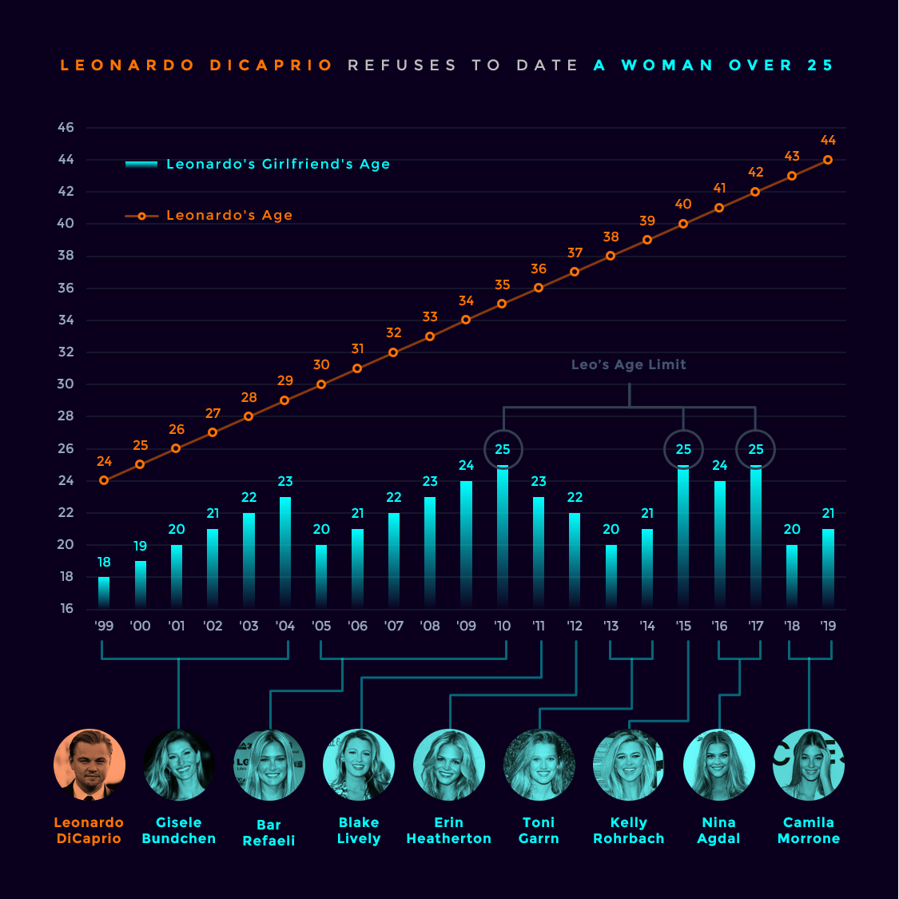
Good or Bad?

Slide 15
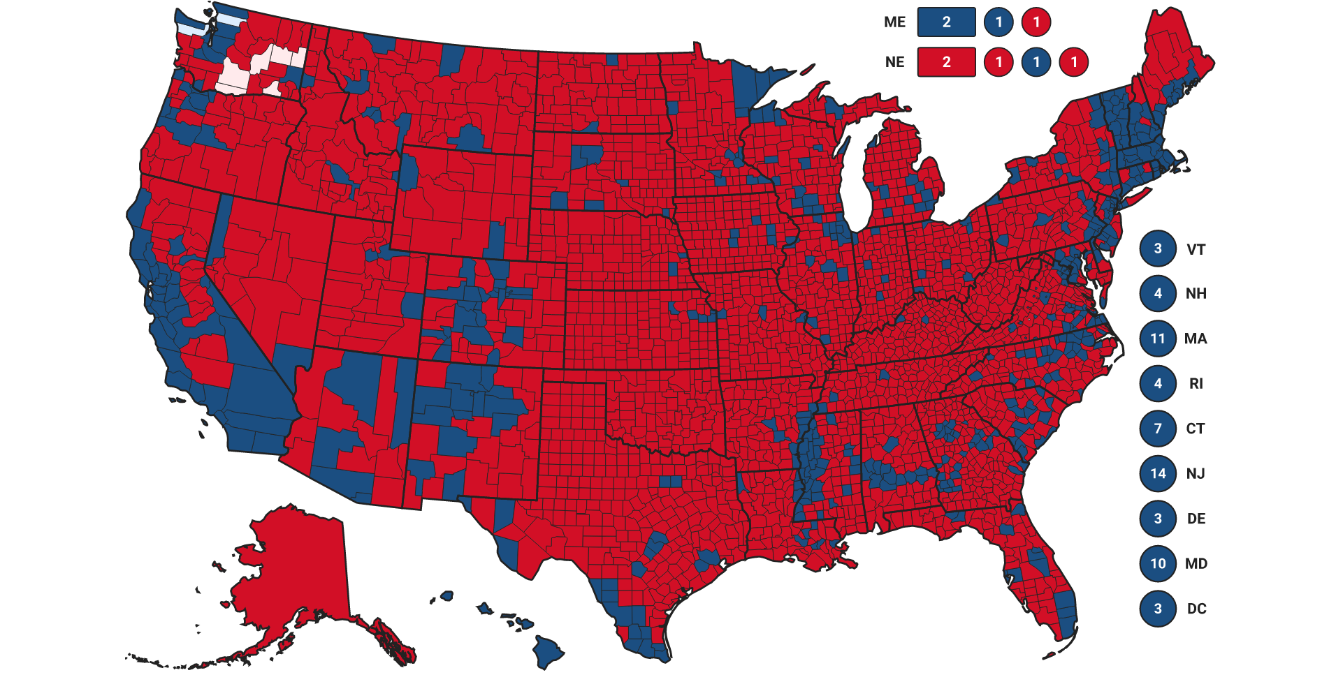
Good or Bad?

Slide 16
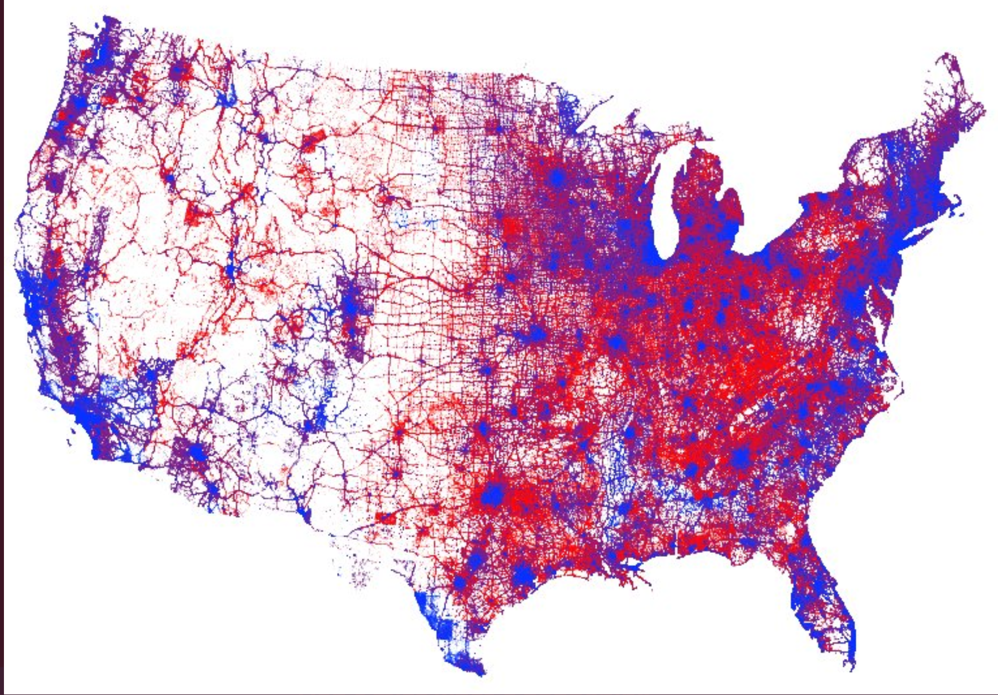
Good or Bad?

Slide 17
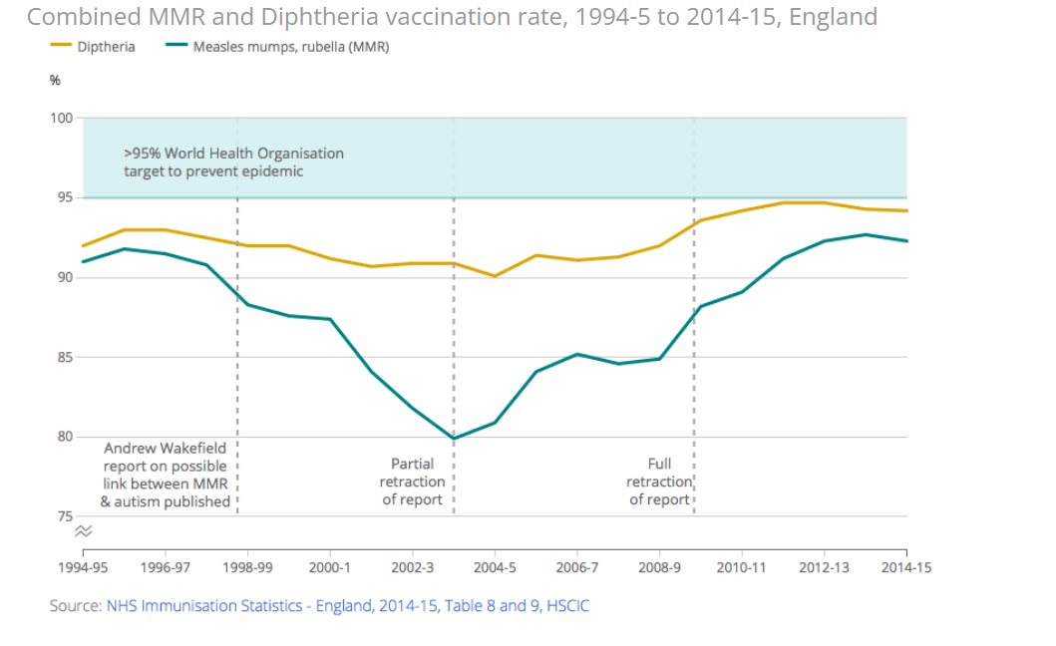
Good or Bad?

Slide 18
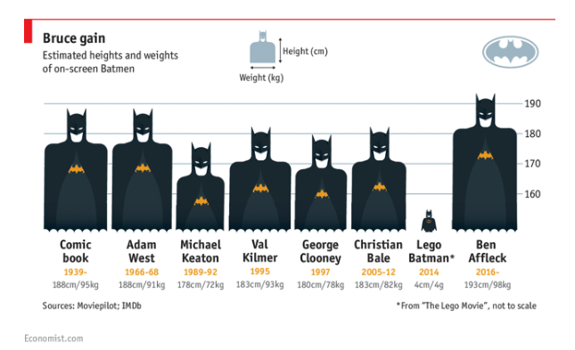
Good or Bad?

Slide 19
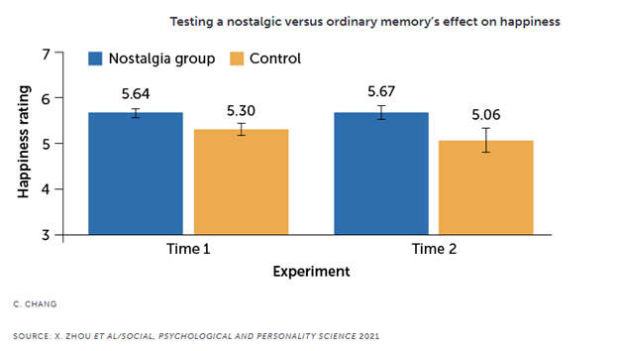
Good or Bad?

Slide 20
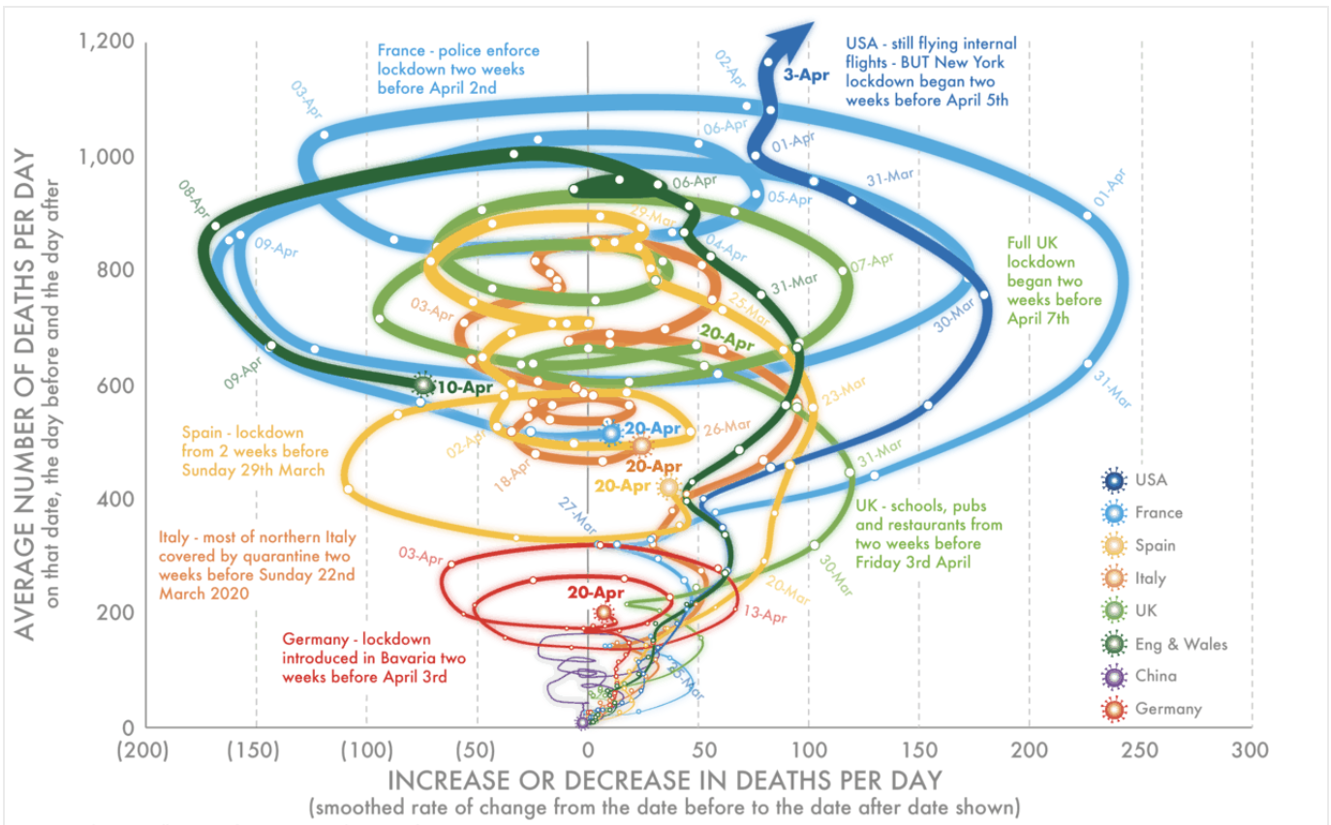
Good or Bad?

Slide 21
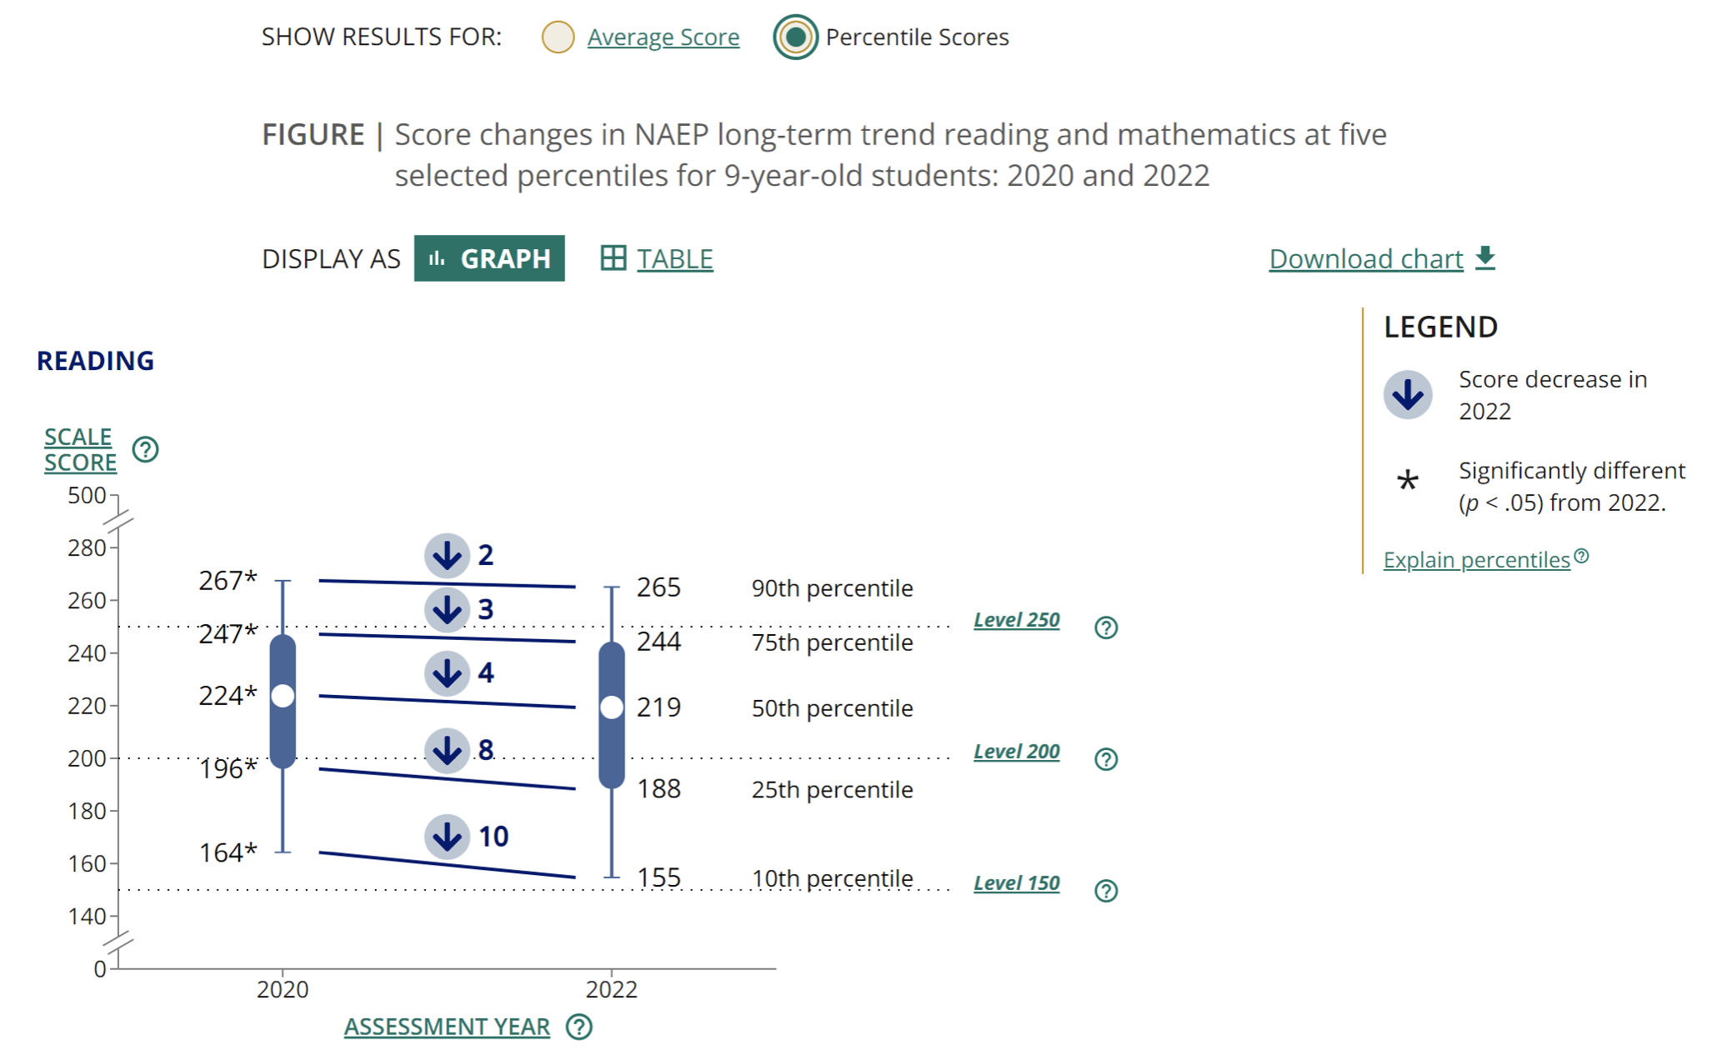
Good or Bad?

Slide 22
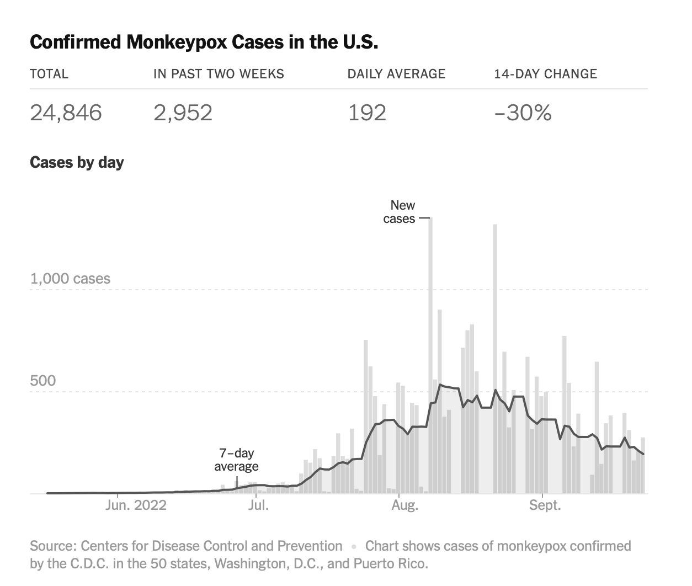
Good or Bad?

Slide 23
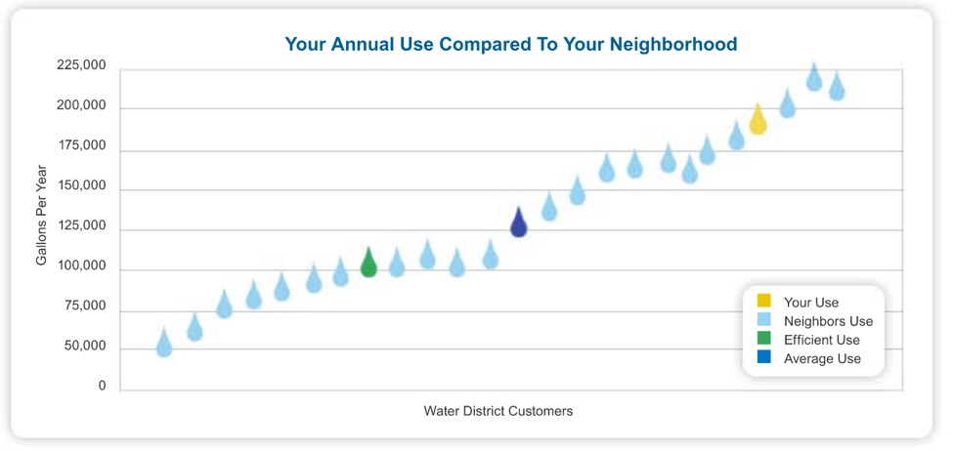
Good or Bad?

Slide 24
Data Visualization

Slide 25
Why Should I Care About Data Visualization
Summarizing huge amounts of information
Seeing the forest and the trees
Errors in probabilistic reasoning
It’s fun!

Slide 26

Why Visualize Data in R
Open source and freeeee
Flexible
Reproducible
Flexible formatting / output
Lots of model- and package-specific support
Did I mention free?

Slide 27

Why Use RStudio (Pivot)
Also free
Basically a GUI for R
Organize files, import data, etc. with ease
RMarkdown, Quarto, and more are powerful tools (they were used to create these slides!)
Lots of new features and support

Slide 28

Why Use the tidyverse
Maintained by RStudio (Pivot)
No one should have to use a for loop to change data from long to wide
Tons of integrated tools for data cleaning, manipulation, transformation, and visualization
Even increasing support for modeling (e.g., tidymodels)

Slide 29


Why Use the tidyverse

Slide 30
Goals for Today
Review core principles of:
dyplr (data manipulation)
tidyr (data transformation and reshaping)

Slide 31

Data Manipulation in dplyr

Slide 32
Core Functions
%>%: The pipe. Read as “and then.”
filter(): Pick observations (rows) by their values.
select(): Pick variables (columns) by their names.
arrange(): Reorder the rows.
group_by(): Implicitly split the data set by grouping by names (columns).
mutate(): Create new variables with functions of existing variables.
summarize() / summarise(): Collapse many values down to a single summary.

Slide 33
Core Functions
%>%
filter()
select()
arrange()
group_by()
mutate()
summarize()
Although each of these functions are powerful alone, they are incredibly powerful in conjunction with one another. So below, I’ll briefly introduce each function, then link them all together using an example of basic data cleaning and summary.

Slide 34
1. %>%
The pipe %>% is wonderful. It makes coding intuitive. Often in coding, you need to use so-called nested functions. For example, you might want to round a number after taking the square of 43.
sqrt(43)
[1] 6.557439
round(sqrt(43), 2)
[1] 6.56

Slide 35
1. %>%
The issue with this comes whenever we need to do a series of operations on a data set or other type of object. In such cases, if we run it in a single call, then we have to start in the middle and read our way out.
round(sqrt(43/2), 2)
[1] 4.64

Slide 36
1. %>%
The pipe solves this by allowing you to read from left to right (or top to bottom). The easiest way to think of it is that each call of %>% reads and operates as “and then.” So with the rounded square root of 43, for example:
sqrt(43) %>% round(2)
[1] 6.56

Slide 37
2. filter()
Often times, when conducting research (experiments or otherwise), there are observations (people, specific trials, etc.) that you don’t want to include.
data(bfi) # grab the bfi data from the psych package bfi <- bfi %>% as_tibble() head(bfi)
# A tibble: 6 × 28 A1 A2 A3 A4 A5 C1 C2 C3 C4 C5 E1 E2 E3 <int> <int> <int> <int> <int> <int> <int> <int> <int> <int> <int> <int> <int> 1 2 4 3 4 4 2 3 3 4 4 3 3 3 2 2 4 5 2 5 5 4 4 3 4 1 1 6 3 5 4 5 4 4 4 5 4 2 5 2 4 4 4 4 4 6 5 5 4 4 3 5 5 5 3 4 5 2 3 3 4 5 4 4 5 3 2 2 2 5 6 6 6 5 6 5 6 6 6 1 3 2 1 6 # … with 15 more variables: E4 <int>, E5 <int>, N1 <int>, N2 <int>, N3 <int>, # N4 <int>, N5 <int>, O1 <int>, O2 <int>, O3 <int>, O4 <int>, O5 <int>, # gender <int>, education <int>, age <int>

Slide 38
2. filter()
Often times, when conducting research (experiments or otherwise), there are observations (people, specific trials, etc.) that you don’t want to include.
summary(bfi$age) # get age descriptives
Min. 1st Qu. Median Mean 3rd Qu. Max. 3.00 20.00 26.00 28.78 35.00 86.00

Slide 39
2. filter()
Often times, when conducting research (experiments or otherwise), there are observations (people, specific trials, etc.) that you don’t want to include.
bfi2 <- bfi %>% # see a pipe! filter(age <= 18) # filter to age up to 18 summary(bfi2$age) # summary of the new data
Min. 1st Qu. Median Mean 3rd Qu. Max. 3.0 16.0 17.0 16.3 18.0 18.0
But this isn’t quite right. We still have folks below 12. But, the beauty of filter() is that you can do sequence of OR and AND statements when there is more than one condition, such as up to 18 AND at least 12.

Slide 40
2. filter()
Often times, when conducting research (experiments or otherwise), there are observations (people, specific trials, etc.) that you don’t want to include.
bfi2 <- bfi %>% filter(age <= 18 & age >= 12) # filter to age up to 18 and at least 12 summary(bfi2$age) # summary of the new data
Min. 1st Qu. Median Mean 3rd Qu. Max. 12.0 16.0 17.0 16.4 18.0 18.0
Got it!

Slide 41
2. filter()
But filter works for more use cases than just conditional
<, >, <=, and >=
It can also be used for cases where we want a single values to match cases with text.
To do that, let’s convert one of the variables in the bfi data frame to a string.
So let’s change gender (1 = male, 2 = female) to text (we’ll get into factors later).
bfi$education <- plyr::mapvalues(bfi$education, 1:5, c("Below HS", "HS", "Some College", "College", "Higher Degree"))

Slide 42
2. filter()
Now let’s try a few things:
1. Create a data set with only individuals with some college (==).
bfi2 <- bfi %>% filter(education == "Some College") unique(bfi2$education)
[1] "Some College"

Slide 43
2. filter()
Now let’s try a few things:
2. Create a data set with only people age 18 (==).
bfi2 <- bfi %>% filter(age == 18) summary(bfi2$age)
Min. 1st Qu. Median Mean 3rd Qu. Max. 18 18 18 18 18 18

Slide 44
2. filter()
Now let’s try a few things:
3. Create a data set with individuals with some college or above (%in%).
bfi2 <- bfi %>% filter(education %in% c("Some College", "College", "Higher Degree")) unique(bfi2$education)
[1] "Some College" "Higher Degree" "College"
%in% is great. It compares a column to a vector rather than just a single value, you can compare it to several
bfi2 <- bfi %>% filter(age %in% 12:18) summary(bfi2$age)
Min. 1st Qu. Median Mean 3rd Qu. Max. 12.0 16.0 17.0 16.4 18.0 18.0

Slide 45
3. select()
If filter() is for pulling certain observations (rows), then select() is for pulling certain variables (columns).
it’s good practice to remove these columns to stop your environment from becoming cluttered and eating up your RAM.

Slide 46
3. select()
In our bfi data, most of these have been pre-removed, so instead, we’ll imagine we don’t want to use any indicators of Agreeableness (A1-A5) and that we aren’t interested in gender.
With select(), there are few ways choose variables. We can bare quote name the ones we want to keep, bare quote names we want to remove, or use any of a number of select() helper functions.

Slide 47
3. select():
A. Bare quote columns we want to keep:

Slide 48
bfi %>% select(C1, C2, C3, C4, C5) %>% print(n = 6)
# A tibble: 2,800 × 5 C1 C2 C3 C4 C5 <int> <int> <int> <int> <int> 1 2 3 3 4 4 2 5 4 4 3 4 3 4 5 4 2 5 4 4 4 3 5 5 5 4 4 5 3 2 6 6 6 6 1 3 # … with 2,794 more rows
bfi %>% select(C1:C5) %>% print(n = 6)
# A tibble: 2,800 × 5 C1 C2 C3 C4 C5 <int> <int> <int> <int> <int> 1 2 3 3 4 4 2 5 4 4 3 4 3 4 5 4 2 5 4 4 4 3 5 5 5 4 4 5 3 2 6 6 6 6 1 3 # … with 2,794 more rows

Slide 49
3. select():
B. Bare quote columns we don’t want to keep:
bfi %>% select(-(A1:A5), -gender) %>% # Note the `()` around the columns print(n = 6)
# A tibble: 2,800 × 22 C1 C2 C3 C4 C5 E1 E2 E3 E4 E5 N1 N2 N3 <int> <int> <int> <int> <int> <int> <int> <int> <int> <int> <int> <int> <int> 1 2 3 3 4 4 3 3 3 4 4 3 4 2 2 5 4 4 3 4 1 1 6 4 3 3 3 3 3 4 5 4 2 5 2 4 4 4 5 4 5 4 4 4 4 3 5 5 5 3 4 4 4 2 5 2 5 4 4 5 3 2 2 2 5 4 5 2 3 4 6 6 6 6 1 3 2 1 6 5 6 3 5 2 # … with 2,794 more rows, and 9 more variables: N4 <int>, N5 <int>, O1 <int>, # O2 <int>, O3 <int>, O4 <int>, O5 <int>, education <chr>, age <int>

Slide 50
3. select():
C. Add or remove using select() helper functions.

Slide 51
starts_with()
ends_with()
contains()
matches()
num_range()
one_of()
all_of()
bfi %>% select(starts_with("C"))
# A tibble: 2,800 × 5 C1 C2 C3 C4 C5 <int> <int> <int> <int> <int> 1 2 3 3 4 4 2 5 4 4 3 4 3 4 5 4 2 5 4 4 4 3 5 5 5 4 4 5 3 2 6 6 6 6 1 3 7 5 4 4 2 3 8 3 2 4 2 4 9 6 6 3 4 5 10 6 5 6 2 1 # … with 2,790 more rows

Slide 52
4. arrange()
Sometimes, either in order to get a better sense of our data or in order to well, order our data, we want to sort it
Although there is a base R sort() function, the arrange() function is tidyverse version that plays nicely with other tidyverse functions.

Slide 53
4. arrange()
So in our previous examples, we could also arrange() our data by age or education, rather than simply filtering. (Or as we’ll see later, we can do both!)
# sort by age bfi %>% select(gender:age) %>% arrange(age) %>% print(n = 6)
# A tibble: 2,800 × 3 gender education age <int> <chr> <int> 1 1 Higher Degree 3 2 2 <NA> 9 3 2 Some College 11 4 2 <NA> 11 5 2 <NA> 11 6 2 <NA> 12 # … with 2,794 more rows
# sort by education bfi %>% select(gender:age) %>% arrange(education) %>% print(n = 6)
# A tibble: 2,800 × 3 gender education age <int> <chr> <int> 1 1 Below HS 19 2 1 Below HS 21 3 1 Below HS 17 4 1 Below HS 18 5 1 Below HS 18 6 2 Below HS 18 # … with 2,794 more rows

Slide 54
4. arrange()
We can also arrange by multiple columns, like if we wanted to sort by gender then education:
bfi %>% select(gender:age) %>% arrange(gender, education) %>% print(n = 6)
# A tibble: 2,800 × 3 gender education age <int> <chr> <int> 1 1 Below HS 19 2 1 Below HS 21 3 1 Below HS 17 4 1 Below HS 18 5 1 Below HS 18 6 1 Below HS 32 # … with 2,794 more rows

Slide 55
Bringing it all together: Split-Apply-Combine

Slide 56
Bringing it all together: Split-Apply-Combine
Much of the power of dplyr functions lay in the split-apply-combine method
A given set of of data are:
split into smaller chunks
then a function or series of functions are applied to each chunk
and then the chunks are combined back together

Slide 57
5. group_by()
The group_by() function is the “split” of the method
It basically implicitly breaks the data set into chunks by whatever bare quoted column(s)/variable(s) are supplied as arguments.

Slide 58
5. group_by()
So imagine that we wanted to group_by() education levels to get average ages at each level
bfi %>% select(starts_with("C"), age, gender, education) %>% group_by(education) %>% print(n = 6)
# A tibble: 2,800 × 8 # Groups: education [6] C1 C2 C3 C4 C5 age gender education <int> <int> <int> <int> <int> <int> <int> <chr> 1 2 3 3 4 4 16 1 <NA> 2 5 4 4 3 4 18 2 <NA> 3 4 5 4 2 5 17 2 <NA> 4 4 4 3 5 5 17 2 <NA> 5 4 4 5 3 2 17 1 <NA> 6 6 6 6 1 3 21 2 Some College # … with 2,794 more rows

Slide 59
5. group_by()
Hadley’s first law of data cleaning: “What is split, must be combined”
This is super easy with the ungroup() function:
bfi %>% select(starts_with("C"), age, gender, education) %>% group_by(education) %>% ungroup() %>% print(n = 6)
# A tibble: 2,800 × 8 C1 C2 C3 C4 C5 age gender education <int> <int> <int> <int> <int> <int> <int> <chr> 1 2 3 3 4 4 16 1 <NA> 2 5 4 4 3 4 18 2 <NA> 3 4 5 4 2 5 17 2 <NA> 4 4 4 3 5 5 17 2 <NA> 5 4 4 5 3 2 17 1 <NA> 6 6 6 6 1 3 21 2 Some College # … with 2,794 more rows

Slide 60
5. group_by()
Multiple group_by() calls overwrites previous calls:
bfi %>% select(starts_with("C"), age, gender, education) %>% group_by(education) %>% group_by(gender, age) %>% print(n = 6)
# A tibble: 2,800 × 8 # Groups: gender, age [115] C1 C2 C3 C4 C5 age gender education <int> <int> <int> <int> <int> <int> <int> <chr> 1 2 3 3 4 4 16 1 <NA> 2 5 4 4 3 4 18 2 <NA> 3 4 5 4 2 5 17 2 <NA> 4 4 4 3 5 5 17 2 <NA> 5 4 4 5 3 2 17 1 <NA> 6 6 6 6 1 3 21 2 Some College # … with 2,794 more rows

Slide 61
6. mutate()
mutate() is one of your “apply” functions
When you use mutate(), the resulting data frame will have the same number of rows you started with
You are directly mutating the existing data frame, either modifying existing columns or creating new ones

Slide 62
6. mutate()
To demonstrate, let’s add a column that indicated average age levels within each age group
bfi %>% select(starts_with("C"), age, gender, education) %>% arrange(education) %>% group_by(education) %>% mutate(age_by_edu = mean(age, na.rm = T)) %>% print(n = 6)
# A tibble: 2,800 × 9 # Groups: education [6] C1 C2 C3 C4 C5 age gender education age_by_edu <int> <int> <int> <int> <int> <int> <int> <chr> <dbl> 1 6 6 3 4 5 19 1 Below HS 25.1 2 4 3 5 3 2 21 1 Below HS 25.1 3 5 5 5 2 2 17 1 Below HS 25.1 4 5 5 4 1 1 18 1 Below HS 25.1 5 4 5 4 3 3 18 1 Below HS 25.1 6 3 2 3 4 6 18 2 Below HS 25.1 # … with 2,794 more rows

Slide 63
6. mutate()
mutate() is also super useful even when you aren’t grouping
We can create a new category
bfi %>% select(starts_with("C"), age, gender, education) %>% mutate(gender_cat = plyr::mapvalues(gender, c(1,2), c("Male", "Female")))
# A tibble: 2,800 × 9 C1 C2 C3 C4 C5 age gender education gender_cat <int> <int> <int> <int> <int> <int> <int> <chr> <chr> 1 2 3 3 4 4 16 1 <NA> Male 2 5 4 4 3 4 18 2 <NA> Female 3 4 5 4 2 5 17 2 <NA> Female 4 4 4 3 5 5 17 2 <NA> Female 5 4 4 5 3 2 17 1 <NA> Male 6 6 6 6 1 3 21 2 Some College Female 7 5 4 4 2 3 18 1 <NA> Male 8 3 2 4 2 4 19 1 HS Male 9 6 6 3 4 5 19 1 Below HS Male 10 6 5 6 2 1 17 2 <NA> Female # … with 2,790 more rows

Slide 64
6. mutate()
mutate() is also super useful even when you aren’t grouping
We could also just overwrite it:
bfi %>% select(starts_with("C"), age, gender, education) %>% mutate(gender = plyr::mapvalues(gender, c(1,2), c("Male", "Female")))
# A tibble: 2,800 × 8 C1 C2 C3 C4 C5 age gender education <int> <int> <int> <int> <int> <int> <chr> <chr> 1 2 3 3 4 4 16 Male <NA> 2 5 4 4 3 4 18 Female <NA> 3 4 5 4 2 5 17 Female <NA> 4 4 4 3 5 5 17 Female <NA> 5 4 4 5 3 2 17 Male <NA> 6 6 6 6 1 3 21 Female Some College 7 5 4 4 2 3 18 Male <NA> 8 3 2 4 2 4 19 Male HS 9 6 6 3 4 5 19 Male Below HS 10 6 5 6 2 1 17 Female <NA> # … with 2,790 more rows

Slide 65
7. summarize() / summarise()
summarize() is one of your “apply” functions
The resulting data frame will have the same number of rows as your grouping variable
You number of groups is 1 for ungrouped data frames
# group_by() education bfi %>% select(starts_with("C"), age, gender, education) %>% arrange(education) %>% group_by(education) %>% summarize(age_by_edu = mean(age, na.rm = T))
# A tibble: 6 × 2 education age_by_edu <chr> <dbl> 1 Below HS 25.1 2 College 33.0 3 Higher Degree 35.3 4 HS 31.5 5 Some College 27.2 6 <NA> 18.0

Slide 66
7. summarize() / summarise()
summarize() is one of your “apply” functions
The resulting data frame will have the same number of rows as your grouping variable
You number of groups is 1 for ungrouped data frames
# no groups bfi %>% select(starts_with("C"), age, gender, education) %>% arrange(education) %>% summarize(age_by_edu = mean(age, na.rm = T))
# A tibble: 1 × 1 age_by_edu <dbl> 1 28.8

Slide 67
Data Wrangling in tidyr

Slide 68
tidyr
Now, let’s build off what we learned from dplyr and focus on reshaping and merging our data.
First, the reshapers:
pivot_longer(), which takes a “wide” format data frame and makes it long.
pivot_wider(), which takes a “long” format data frame and makes it wide.

Slide 69
tidyr
Next, the mergers:
full_join(), which merges all rows in either data frame
inner_join(), which merges rows whose keys are present in both data frames
left_join(), which “prioritizes” the first data set
right_join(), which “prioritizes” the second data set
(See also:anti_join() and semi_join())

Slide 70
Key tidyr Functions

Slide 71
1. pivot_longer()
(Formerly gather()) Makes wide data long, based on a key
Core arguments:
data: the data, blank if piped
cols: columns to be made long, selected via select() calls
names_to: name(s) of key column(s) in new long data frame (string or string vector)
values_to: name of values in new long data frame (string)
names_sep: separator in column headers, if multiple keys
values_drop_na: drop missing cells (similar to na.rm = T)

Slide 72
1. pivot_longer(): Basic Application
Let’s start with an easy one – one key, one value:

Slide 73
bfi %>% rownames_to_column("SID") %>% pivot_longer( cols = A1:O5 , names_to = "item" , values_to = "values" , values_drop_na = T ) %>% print(n = 8)
# A tibble: 69,492 × 6 SID gender education age item values <chr> <int> <chr> <int> <chr> <int> 1 1 1 <NA> 16 A1 2 2 1 1 <NA> 16 A2 4 3 1 1 <NA> 16 A3 3 4 1 1 <NA> 16 A4 4 5 1 1 <NA> 16 A5 4 6 1 1 <NA> 16 C1 2 7 1 1 <NA> 16 C2 3 8 1 1 <NA> 16 C3 3 # … with 69,484 more rows

Slide 74
1. pivot_longer(): More Advanced Application
Now a harder one – two keys, one value:

Slide 75
bfi %>% rownames_to_column("SID") %>% pivot_longer( cols = A1:O5 , names_to = c("trait", "item_num") , names_sep = -1 , values_to = "values" , values_drop_na = T ) %>% print(n = 8)
# A tibble: 69,492 × 7 SID gender education age trait item_num values <chr> <int> <chr> <int> <chr> <chr> <int> 1 1 1 <NA> 16 A 1 2 2 1 1 <NA> 16 A 2 4 3 1 1 <NA> 16 A 3 3 4 1 1 <NA> 16 A 4 4 5 1 1 <NA> 16 A 5 4 6 1 1 <NA> 16 C 1 2 7 1 1 <NA> 16 C 2 3 8 1 1 <NA> 16 C 3 3 # … with 69,484 more rows

Slide 76
2. pivot_wider()
(Formerly spread()) Makes wide data long, based on a key
Core arguments:
data: the data, blank if piped
names_from: name(s) of key column(s) in new long data frame (string or string vector)
names_sep: separator in column headers, if multiple keys
names_glue: specify multiple or custom separators of multiple keys
values_from: name of values in new long data frame (string)
values_fn: function applied to data with duplicate labels

Slide 77
2. pivot_wider(): Basic Application
bfi_long %>% pivot_wider( names_from = "item" , values_from = "values" )
# A tibble: 2,800 × 29 SID gender education age A1 A2 A3 A4 A5 C1 C2 C3 <chr> <int> <chr> <int> <int> <int> <int> <int> <int> <int> <int> <int> 1 1 1 <NA> 16 2 4 3 4 4 2 3 3 2 2 2 <NA> 18 2 4 5 2 5 5 4 4 3 3 2 <NA> 17 5 4 5 4 4 4 5 4 4 4 2 <NA> 17 4 4 6 5 5 4 4 3 5 5 1 <NA> 17 2 3 3 4 5 4 4 5 6 6 2 Some Coll… 21 6 6 5 6 5 6 6 6 7 7 1 <NA> 18 2 5 5 3 5 5 4 4 8 8 1 HS 19 4 3 1 5 1 3 2 4 9 9 1 Below HS 19 4 3 6 3 3 6 6 3 10 10 2 <NA> 17 2 5 6 6 5 6 5 6 # … with 2,790 more rows, and 17 more variables: C4 <int>, C5 <int>, E1 <int>, # E2 <int>, E3 <int>, E4 <int>, E5 <int>, N1 <int>, N2 <int>, N3 <int>, # N4 <int>, N5 <int>, O1 <int>, O2 <int>, O3 <int>, O4 <int>, O5 <int>

Slide 78
2. pivot_wider(): More Advanced
bfi_long %>% pivot_wider( names_from = c("trait", "item_num") , values_from = "values" , names_sep = "_" )
# A tibble: 2,800 × 29 SID gender education age A_1 A_2 A_3 A_4 A_5 C_1 C_2 C_3 <chr> <int> <chr> <int> <int> <int> <int> <int> <int> <int> <int> <int> 1 1 1 <NA> 16 2 4 3 4 4 2 3 3 2 2 2 <NA> 18 2 4 5 2 5 5 4 4 3 3 2 <NA> 17 5 4 5 4 4 4 5 4 4 4 2 <NA> 17 4 4 6 5 5 4 4 3 5 5 1 <NA> 17 2 3 3 4 5 4 4 5 6 6 2 Some Coll… 21 6 6 5 6 5 6 6 6 7 7 1 <NA> 18 2 5 5 3 5 5 4 4 8 8 1 HS 19 4 3 1 5 1 3 2 4 9 9 1 Below HS 19 4 3 6 3 3 6 6 3 10 10 2 <NA> 17 2 5 6 6 5 6 5 6 # … with 2,790 more rows, and 17 more variables: C_4 <int>, C_5 <int>, # E_1 <int>, E_2 <int>, E_3 <int>, E_4 <int>, E_5 <int>, N_1 <int>, # N_2 <int>, N_3 <int>, N_4 <int>, N_5 <int>, O_1 <int>, O_2 <int>, # O_3 <int>, O_4 <int>, O_5 <int>

Slide 79
2. pivot_wider(): A Little More Advanced
bfi_long %>% select(-item_num) %>% pivot_wider( names_from = "trait" , values_from = "values" , names_sep = "_" , values_fn = mean )
# A tibble: 2,800 × 9 SID gender education age A C E N O <chr> <int> <chr> <int> <dbl> <dbl> <dbl> <dbl> <dbl> 1 1 1 <NA> 16 3.4 3.2 3.4 2.8 3.8 2 2 2 <NA> 18 3.6 4 3 3.8 3.2 3 3 2 <NA> 17 4.4 4 3.8 3.6 3.6 4 4 2 <NA> 17 4.8 4.2 4 2.8 3.6 5 5 1 <NA> 17 3.4 3.6 3.6 3.2 3.2 6 6 2 Some College 21 5.6 4.4 4 3 3.8 7 7 1 <NA> 18 4 3.6 4.2 1.4 3.8 8 8 1 HS 19 2.8 3 3.2 4.2 3.4 9 9 1 Below HS 19 3.8 4.8 3.75 3.6 5 10 10 2 <NA> 17 4.8 4 3.6 4.2 3.6 # … with 2,790 more rows

Slide 80
More dplyr Functions

Slide 81
The _join() Functions
Often we may need to pull different data from different sources
There are lots of reasons to need to do this
We don’t have time to get into all the use cases here, so we’ll talk about them in high level terms
We’ll focus on:
full_join()
inner_join()
left_join()
right_join()

Slide 82
The _join() Functions
Let’s separate demographic and BFI data

Slide 83
bfi_only <- bfi %>% rownames_to_column("SID") %>% select(SID, matches("[0-9]")) bfi_only %>% print(n = 6)
# A tibble: 2,800 × 26 SID A1 A2 A3 A4 A5 C1 C2 C3 C4 C5 E1 E2 <chr> <int> <int> <int> <int> <int> <int> <int> <int> <int> <int> <int> <int> 1 1 2 4 3 4 4 2 3 3 4 4 3 3 2 2 2 4 5 2 5 5 4 4 3 4 1 1 3 3 5 4 5 4 4 4 5 4 2 5 2 4 4 4 4 4 6 5 5 4 4 3 5 5 5 3 5 5 2 3 3 4 5 4 4 5 3 2 2 2 6 6 6 6 5 6 5 6 6 6 1 3 2 1 # … with 2,794 more rows, and 13 more variables: E3 <int>, E4 <int>, E5 <int>, # N1 <int>, N2 <int>, N3 <int>, N4 <int>, N5 <int>, O1 <int>, O2 <int>, # O3 <int>, O4 <int>, O5 <int>
bfi_dem <- bfi %>% rownames_to_column("SID") %>% select(SID, education, gender, age) bfi_dem %>% print(n = 6)
# A tibble: 2,800 × 4 SID education gender age <chr> <chr> <int> <int> 1 1 <NA> 1 16 2 2 <NA> 2 18 3 3 <NA> 2 17 4 4 <NA> 2 17 5 5 <NA> 1 17 6 6 Some College 2 21 # … with 2,794 more rows

Slide 84
3. full_join()
Most simply, we can put those back together keeping all observations.

Slide 85
bfi_only %>% full_join(bfi_dem) %>% print(n = 6)
# A tibble: 2,800 × 29 SID A1 A2 A3 A4 A5 C1 C2 C3 C4 C5 E1 E2 <chr> <int> <int> <int> <int> <int> <int> <int> <int> <int> <int> <int> <int> 1 1 2 4 3 4 4 2 3 3 4 4 3 3 2 2 2 4 5 2 5 5 4 4 3 4 1 1 3 3 5 4 5 4 4 4 5 4 2 5 2 4 4 4 4 4 6 5 5 4 4 3 5 5 5 3 5 5 2 3 3 4 5 4 4 5 3 2 2 2 6 6 6 6 5 6 5 6 6 6 1 3 2 1 # … with 2,794 more rows, and 16 more variables: E3 <int>, E4 <int>, E5 <int>, # N1 <int>, N2 <int>, N3 <int>, N4 <int>, N5 <int>, O1 <int>, O2 <int>, # O3 <int>, O4 <int>, O5 <int>, education <chr>, gender <int>, age <int>
bfi %>% rownames_to_column("SID") %>% print(n = 6)
# A tibble: 2,800 × 29 SID A1 A2 A3 A4 A5 C1 C2 C3 C4 C5 E1 E2 <chr> <int> <int> <int> <int> <int> <int> <int> <int> <int> <int> <int> <int> 1 1 2 4 3 4 4 2 3 3 4 4 3 3 2 2 2 4 5 2 5 5 4 4 3 4 1 1 3 3 5 4 5 4 4 4 5 4 2 5 2 4 4 4 4 4 6 5 5 4 4 3 5 5 5 3 5 5 2 3 3 4 5 4 4 5 3 2 2 2 6 6 6 6 5 6 5 6 6 6 1 3 2 1 # … with 2,794 more rows, and 16 more variables: E3 <int>, E4 <int>, E5 <int>, # N1 <int>, N2 <int>, N3 <int>, N4 <int>, N5 <int>, O1 <int>, O2 <int>, # O3 <int>, O4 <int>, O5 <int>, gender <int>, education <chr>, age <int>

Slide 86
4. inner_join()
We can also keep all rows present in both data frames

Slide 87
bfi_dem %>% filter(row_number() %in% 1:1700) %>% inner_join( bfi_only %>% filter(row_number() %in% 1200:2800) ) %>% print(n = 6)
# A tibble: 501 × 29 SID education gender age A1 A2 A3 A4 A5 C1 C2 C3 <chr> <chr> <int> <int> <int> <int> <int> <int> <int> <int> <int> <int> 1 1200 Some Colle… 2 18 1 5 6 5 5 5 6 5 2 1201 College 2 29 1 5 6 5 5 2 1 4 3 1202 Higher Deg… 1 46 2 5 6 5 6 6 6 6 4 1203 Higher Deg… 1 58 5 4 4 4 5 4 4 5 5 1204 Higher Deg… 2 38 1 4 6 6 6 4 4 5 6 1205 Higher Deg… 2 27 2 3 1 1 1 4 2 2 # … with 495 more rows, and 17 more variables: C4 <int>, C5 <int>, E1 <int>, # E2 <int>, E3 <int>, E4 <int>, E5 <int>, N1 <int>, N2 <int>, N3 <int>, # N4 <int>, N5 <int>, O1 <int>, O2 <int>, O3 <int>, O4 <int>, O5 <int>
bfi %>% rownames_to_column("SID") %>% print(n = 6)
# A tibble: 2,800 × 29 SID A1 A2 A3 A4 A5 C1 C2 C3 C4 C5 E1 E2 <chr> <int> <int> <int> <int> <int> <int> <int> <int> <int> <int> <int> <int> 1 1 2 4 3 4 4 2 3 3 4 4 3 3 2 2 2 4 5 2 5 5 4 4 3 4 1 1 3 3 5 4 5 4 4 4 5 4 2 5 2 4 4 4 4 4 6 5 5 4 4 3 5 5 5 3 5 5 2 3 3 4 5 4 4 5 3 2 2 2 6 6 6 6 5 6 5 6 6 6 1 3 2 1 # … with 2,794 more rows, and 16 more variables: E3 <int>, E4 <int>, E5 <int>, # N1 <int>, N2 <int>, N3 <int>, N4 <int>, N5 <int>, O1 <int>, O2 <int>, # O3 <int>, O4 <int>, O5 <int>, gender <int>, education <chr>, age <int>

Slide 88
5. left_join()
Or all rows present in the left (first) data frame, perhaps if it’s a subset of people with complete data

Slide 89
bfi_dem %>% drop_na() %>% left_join(bfi_only) %>% print(n = 6)
# A tibble: 2,577 × 29 SID education gender age A1 A2 A3 A4 A5 C1 C2 C3 <chr> <chr> <int> <int> <int> <int> <int> <int> <int> <int> <int> <int> 1 6 Some Colle… 2 21 6 6 5 6 5 6 6 6 2 8 HS 1 19 4 3 1 5 1 3 2 4 3 9 Below HS 1 19 4 3 6 3 3 6 6 3 4 11 Below HS 1 21 4 4 5 6 5 4 3 5 5 15 Below HS 1 17 4 5 2 2 1 5 5 5 6 23 Higher Deg… 1 68 1 5 6 5 6 4 3 2 # … with 2,571 more rows, and 17 more variables: C4 <int>, C5 <int>, E1 <int>, # E2 <int>, E3 <int>, E4 <int>, E5 <int>, N1 <int>, N2 <int>, N3 <int>, # N4 <int>, N5 <int>, O1 <int>, O2 <int>, O3 <int>, O4 <int>, O5 <int>
bfi %>% rownames_to_column("SID") %>% print(n = 6)
# A tibble: 2,800 × 29 SID A1 A2 A3 A4 A5 C1 C2 C3 C4 C5 E1 E2 <chr> <int> <int> <int> <int> <int> <int> <int> <int> <int> <int> <int> <int> 1 1 2 4 3 4 4 2 3 3 4 4 3 3 2 2 2 4 5 2 5 5 4 4 3 4 1 1 3 3 5 4 5 4 4 4 5 4 2 5 2 4 4 4 4 4 6 5 5 4 4 3 5 5 5 3 5 5 2 3 3 4 5 4 4 5 3 2 2 2 6 6 6 6 5 6 5 6 6 6 1 3 2 1 # … with 2,794 more rows, and 16 more variables: E3 <int>, E4 <int>, E5 <int>, # N1 <int>, N2 <int>, N3 <int>, N4 <int>, N5 <int>, O1 <int>, O2 <int>, # O3 <int>, O4 <int>, O5 <int>, gender <int>, education <chr>, age <int>

Slide 90
6. right_join()
Or all rows present in the right (second) data frame, such as I do when I join a codebook with raw data

Slide 91
bfi_dem %>% drop_na() %>% right_join(bfi_only) %>% print(n = 6)
# A tibble: 2,800 × 29 SID education gender age A1 A2 A3 A4 A5 C1 C2 C3 <chr> <chr> <int> <int> <int> <int> <int> <int> <int> <int> <int> <int> 1 6 Some Colle… 2 21 6 6 5 6 5 6 6 6 2 8 HS 1 19 4 3 1 5 1 3 2 4 3 9 Below HS 1 19 4 3 6 3 3 6 6 3 4 11 Below HS 1 21 4 4 5 6 5 4 3 5 5 15 Below HS 1 17 4 5 2 2 1 5 5 5 6 23 Higher Deg… 1 68 1 5 6 5 6 4 3 2 # … with 2,794 more rows, and 17 more variables: C4 <int>, C5 <int>, E1 <int>, # E2 <int>, E3 <int>, E4 <int>, E5 <int>, N1 <int>, N2 <int>, N3 <int>, # N4 <int>, N5 <int>, O1 <int>, O2 <int>, O3 <int>, O4 <int>, O5 <int>
bfi %>% rownames_to_column("SID") %>% print(n = 6)
# A tibble: 2,800 × 29 SID A1 A2 A3 A4 A5 C1 C2 C3 C4 C5 E1 E2 <chr> <int> <int> <int> <int> <int> <int> <int> <int> <int> <int> <int> <int> 1 1 2 4 3 4 4 2 3 3 4 4 3 3 2 2 2 4 5 2 5 5 4 4 3 4 1 1 3 3 5 4 5 4 4 4 5 4 2 5 2 4 4 4 4 4 6 5 5 4 4 3 5 5 5 3 5 5 2 3 3 4 5 4 4 5 3 2 2 2 6 6 6 6 5 6 5 6 6 6 1 3 2 1 # … with 2,794 more rows, and 16 more variables: E3 <int>, E4 <int>, E5 <int>, # N1 <int>, N2 <int>, N3 <int>, N4 <int>, N5 <int>, O1 <int>, O2 <int>, # O3 <int>, O4 <int>, O5 <int>, gender <int>, education <chr>, age <int>

